Slide 1
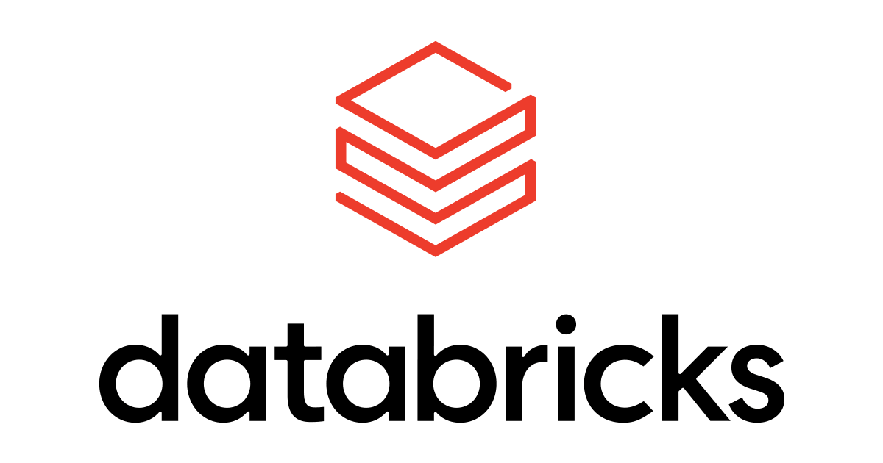
Overview
Bryan Cafferky
Data & AI Enabler

Slide 2



About Bryan Cafferky…
Big Data and AI Consultant and Microsoft Certified Azure Data Scientist.
Microsoft Data Science Training Content Developer. https://docs.microsoft.com/en-us/learn/
Decades of IT Experience.
Past Microsoft Data Platform MVP and Cloud and Data Center MVP.
Author of Master Azure Databricks Step By Step available on Amazon.
Author of Pro PowerShell for Database Developers by Apress.
Experienced in health care, insurance, banking, and ecommerce.
Founded and lead PASS Chapter The RI Business Intelligence User Group.
https://www.linkedin.com/in/bryancafferky
Subscribe to my YouTube Channel

Slide 3

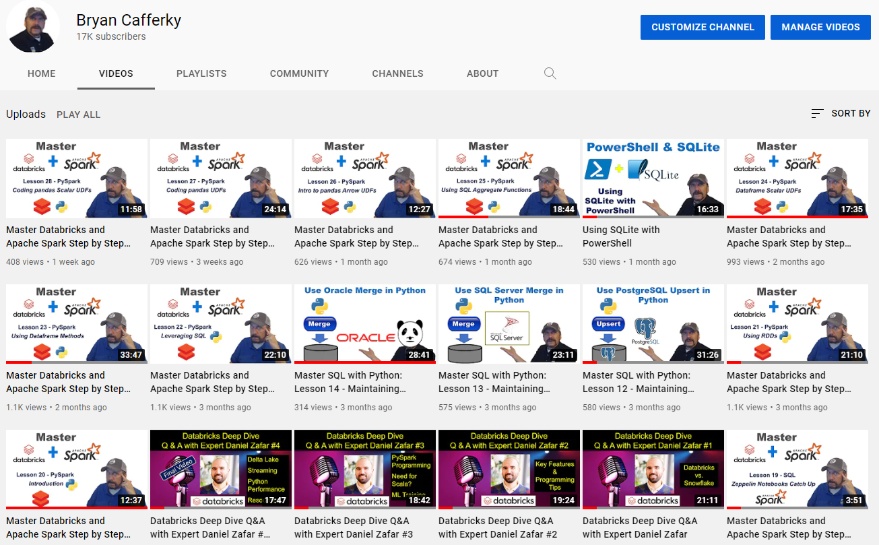
Subscribe to my YouTube Channel
https://www.youtube.com/c/BryanCafferky

Slide 4


Where Are We Going?
What is Apache Spark?
What is Databricks?
Scaling Up and Out with Barry the Weightlifter
Understanding Apache Spark and Databricks
Riveting Demonstration

Slide 5

"Important information follows..."

Slide 6
What is Apache Spark?
An open-source big data platform for data science
Big Data means challenging data and includes massive data volume, streaming data, unstructured and semi-structured data, images, video, sound.
Bring your own tools
Weak support for collaboration
Not optimized for the cloud

Slide 7
What is Databricks?
Commercial product from the creators of Apache Spark
Complete development environment for Apache Spark
Numerous proprietary Spark enhancements
Ideal for Data Science team collaboration
Many development tools
Optimized for the Cloud (AWS, Azure, GCP)

Slide 8
What Makes a Big Data Platform Different?

Slide 9

Scale Up, Scale Out,
and
Barry the Weightlifter

Slide 10

Scale Up vs. Scale Out
Scale Up
Scale Out

Slide 11

Scaling Out
Scale Out

Slide 12


The Apache Hadoop project

Slide 13

Apache Hadoop and My Kitchen Drawer

Slide 14
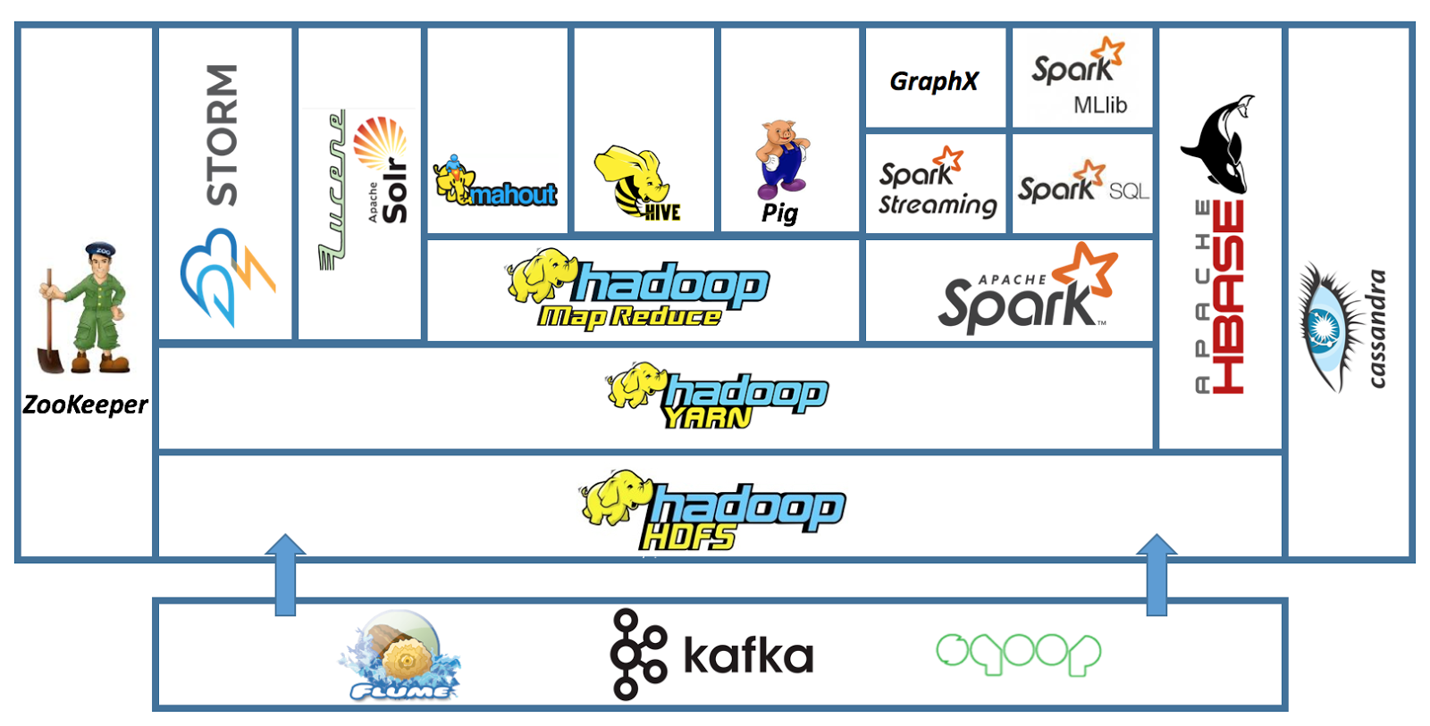
The Apache Hadoop Ecosystem
Databricks
Streaming
In Memory
NoSQL
Databases
Distributed
System
Coordination
Full Text
Search
Machine Learning
SQL
ETL
Real Time
H
a
d
o
o
p
B
A
T
C
H
Move Data to/From SQL Databases
Queuing Service
Streaming

Slide 15
General Spark Cluster Architecture
Python Code Must Be Copied to Every Node
Driver Program SparkContext
‘Driver’ runs the user’s ‘main’ function and executes the various parallel operations on the worker nodes.
The results of the operations are collected by the driver
The worker nodes read and write data from/to Data Sources including HDFS.
Worker node also cache transformed data in memory as RDDs (Resilient Data Sets).
Worker nodes and the Driver Node execute as VMs in public clouds (AWS, Google and Azure).
Cluster Manager
Worker Node
Worker Node
Worker Node
Cache
Cache
Cache
Task
Task
Task
Data Sources (HDFS, SQL, NoSQL, …)

Slide 16




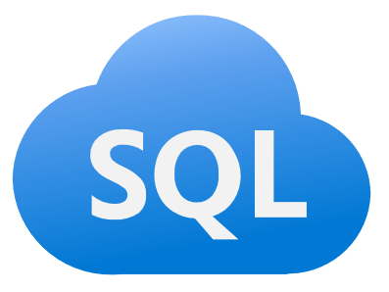
Apache Spark
A unified, open source, parallel, data processing framework for Big Data Analytics
Spark SQL
Interactive Queries
Spark MLlib
Machine Learning
Spark Streaming
Stream processing
GraphX
Graph Computation
Spark Unifies:
Batch Processing
Interactive SQL
Real-time processing
Machine Learning
Deep Learning
Graph Processing
Spark Core Engine
Yarn
Mesos
Standalone Scheduler
Spark MLlib
Machine Learning
Spark Structured Streaming
Stream processing

Slide 17
Apache Spark
Python is not Supported by Spark (directly)
PySpark
Spark SQL
Interactive Queries
Spark MLlib
Machine Learning
Spark Streaming
Stream processing
GraphX
Graph Computation
Spark Unifies:
Batch Processing
Interactive SQL
Real-time processing
Machine Learning
Deep Learning
Graph Processing
Spark Core Engine
Yarn
Mesos
Standalone Scheduler
Spark Structured Streaming
Stream processing
The PySpark Package Wraps the Spark APIs

Slide 18
Ok, But What is Databricks?

Slide 19
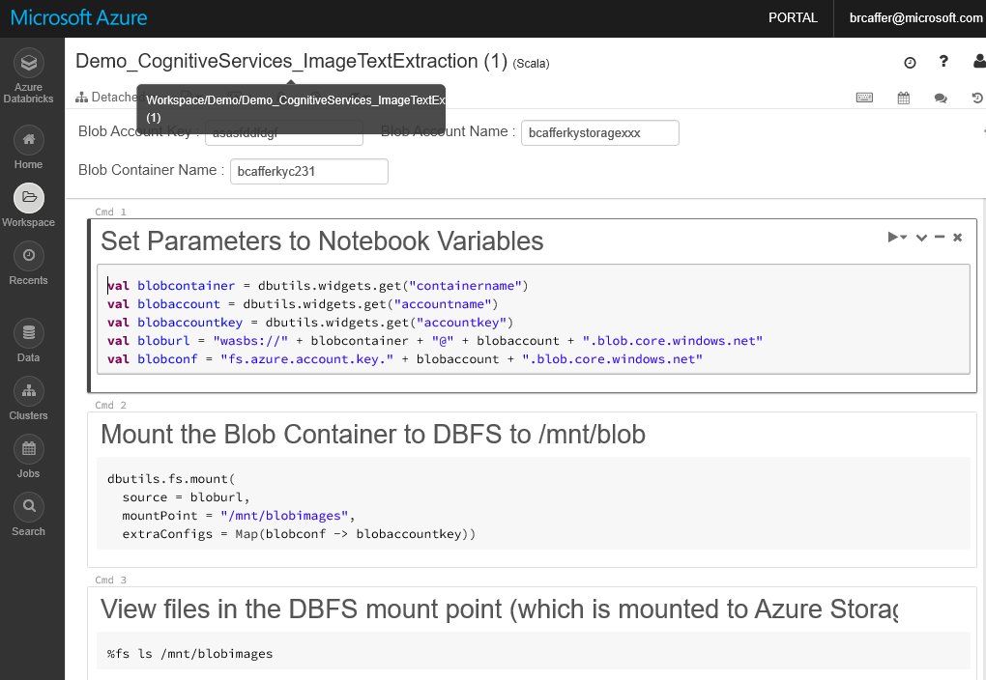
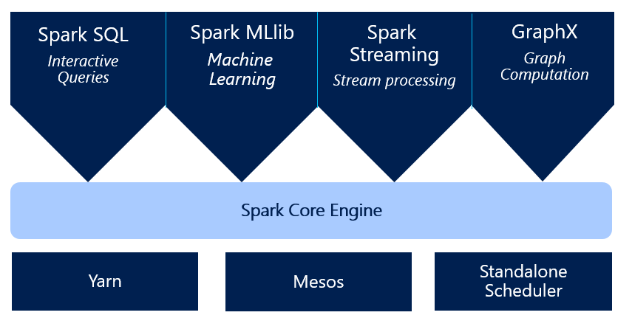
Databricks
Notebooks
Integrated Blob File System
Secure Collaboration
Cluster Creation
Language Extensions
Job Scheduler
Spark Optimizations

Slide 20

Creating a Cluster
Uploading Data
Workspace
Using Notebooks
Dashboards
Importing
Security
Cell Actions
Schedule
Revision History
Comments
Libraries
Jobs

Slide 21
Demo

Slide 22




Azure
Clusters
Folders
Libraries
Notebooks
Security
Jobs

Slide 23


Apache Spark vs. Databricks
Apache Spark
Databricks

Slide 24

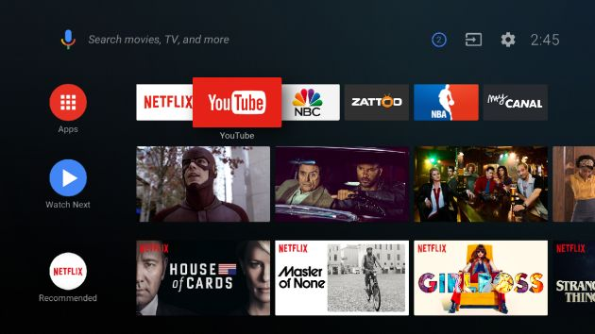
You want to stream your favorite show…
Apache Spark
Databricks

Slide 25
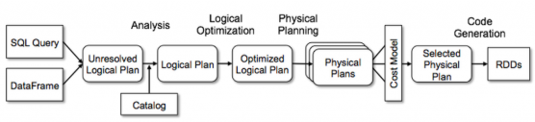
SQL for Performance

Slide 26

The Future of Data Warehouses
SQL Support
Transactions
Logging
Query Tuning
Optimized Storage Format
AWS RedShift
Spark
Teradata
Azure Synapse
MapReduce
Snowflake
Relational
Non-Relational

Slide 27
Wrapping Up
What is Apache Spark?
What is Databricks?
Scaling Up, Scaling Out and Barry the Weightlifter
Apache Hadoop and My Kitchen Drawer
Riveting Demonstration
Thank You!

